Slide 1

CS4248 Intermediate Update
Junhao Huang <e0950322@u.nus.edu>
Modi Trushti Sanjaybhai <e0550529@u.nus.edu>
Sagar Sureka <e0426366@u.nus.edu>
Zhan Rongrong <e0950247@u.nus.edu>
Zhehao Gu <e0950095@u.nus.edu>
Project mentor: Hai Ye <hye.me@outlook.com>

Slide 2
Abstract
In this project, we will work on the Labeled Unreliable News
(LUN) dataset and create a model for 4-class classification.
The 4 classes of classification are: Satire, Hoax, Propaganda, and Reliable News.
Apart from working on this Intermediate Update, the team has
discussed possible problems we might face, discussed models we
want to consider, explored literature review and also started on some
data preprocessing tasks.
Notes:
Sagar
Work with the Labeled Unreliable News Dataset and train models which try to accurately classify documents/news between 4 labels.

Slide 3
Motivation
Fake News is not as easy to spot as we think. 91% participants in a study chose at least 1 fake news to be real (Ref. 9).
Very relevant problem in the last few years – Coronavirus Pandemic, Russia-Ukraine War. Misleading or misinforming content can intensify conflicts.
A good model to check the authenticity of news present online can possibly greatly improve the quality of social media news information.
We feel this could be a good opportunity to learn about different models and fitting them into a particular problem context.
Notes:
Sagar
Fake news—news articles that are intentionally and verifiably false designed to manipulate people’s perceptions of reality—has been used to influence politics and promote advertising. But it has also become a method to stir up and intensify social conflict. - https://www.cits.ucsb.edu/fake-news/danger-social
NewsGuard’s Misinformation Monitor, a fact-checking bulletin, reported an investigation in March 2022: Within 40 minutes of joining the TikTok app, accounts were shown misleading content about the war in Ukraine. These claims were both pro-Russian and pro-Ukranian, but were all false. - https://www.cits.ucsb.edu/fake-news/danger-social

Slide 4
Task Statement
The task is to classify an input news article/text into one of 4 classes – Satire, Hoax, Propaganda or Reliable News.
Additionally, analyze and evaluate the performance of the trained model on the classification of input texts.
Notes:
Sagar

Slide 5
Proposed Method
Method |  | Details
Preprocessing | Tokenization: word tokens vs byte-pair subword tokens Case-folding Lemmatization/stemming/none Stopwords removal Long sentence solution
Model1: BiLSTM + pre-trained word embedding | Utilize bidirectional context and pretrained word embedding Use LSTM to capture long term dependency
Model2: BERT/RoBERTa | Finetune pretrained encoders to learn better representation and make predictions
Model3: XLNet | AR pretraining method with permutation operation Accessible to bidirectional context without data corruption
Notes:
Give an outline of the project’s intended method, giving the overall plans for investigation.
The scope of the basic project should be made clear; with any optional deliverables mentioned.
This section should link well with the proposed schedule and role assignment slides.
Where appropriate, reference methods to be taken from the textbook chapters, online posts or scientific literature.
Your group is not bound to execute the proposed method; it is expected that minor deviations are expected in your final report. Large changes in overall project scope should be communicated to your project mentor.

Slide 6
Proposed Method: BERT
Bidirectional encoder representations from transformers. A pretrained encoder that gets bidirectional context and hence learns better representation.
Link: BERT: Pre-training of Deep Bidirectional Transformers for Language Understanding
Pretraining idea:
Replace some fraction of words in the input with a special [MASK] token and predict these words. (Not exactly, in the paper there was more randomness added)
h1,…,hT = Encoder(w1,…,wT), yi~Awi+b
During pretraining, only add loss from words that are masked out. And then propagate the loss back to learn the parameters of the entire network. It's also called Masked LM

Slide 7
Proposed Method: RoBERTa
An improved pretraining procedure based on BERT, which achieves state-of-the-art results on multiple tasks and suggests that BERT’s pretraining objective remains competitive with recently proposed alternatives.
Link: RoBERTa: A Robustly Optimized BERT Pretraining Approach
Motivations:
The hyperparameter choices may have significant impact on the final results. But this seems to be underestimated by BERT and it does not provide much to tune.
Different with BERT, RoBERTa turns to use dynamic masking, drop next sentence prediction(NSP) target during pretraining, larger byte-level in byte-pair encoding(BPE) and so on. Although the training speed is slower, the model performs much better than the origin BERT.

Slide 8
Proposed Method: XLNet
A pretraining method that uses a permutation language modeling objective to combine the advantages of autoregression(AR) and autoencoding(AE) methods.
Link: XLNet: Generalized Autoregressive Pretraining for Language Understanding
Motivations:
As an AR pretraining method, XLNet does not depend on data corruption, so that it avoids the missing tokens in fine-tunning step. E.g., masked tokens in BERT;
Based on permutation operation, XLNet can learn the bi-direction information. More specifically, a text sequence with length L can be permutated in L! ways. If we share the model parameters with all of them, bi-direction information can be learnt just like AE;
Integrated the idea of Transformer-XL, XLNet use segment recurrence and relative encoding to improve long-text situation, which would benefit the data we chosen.

Slide 9
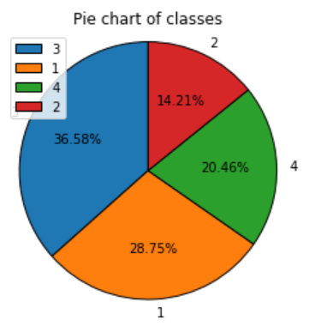
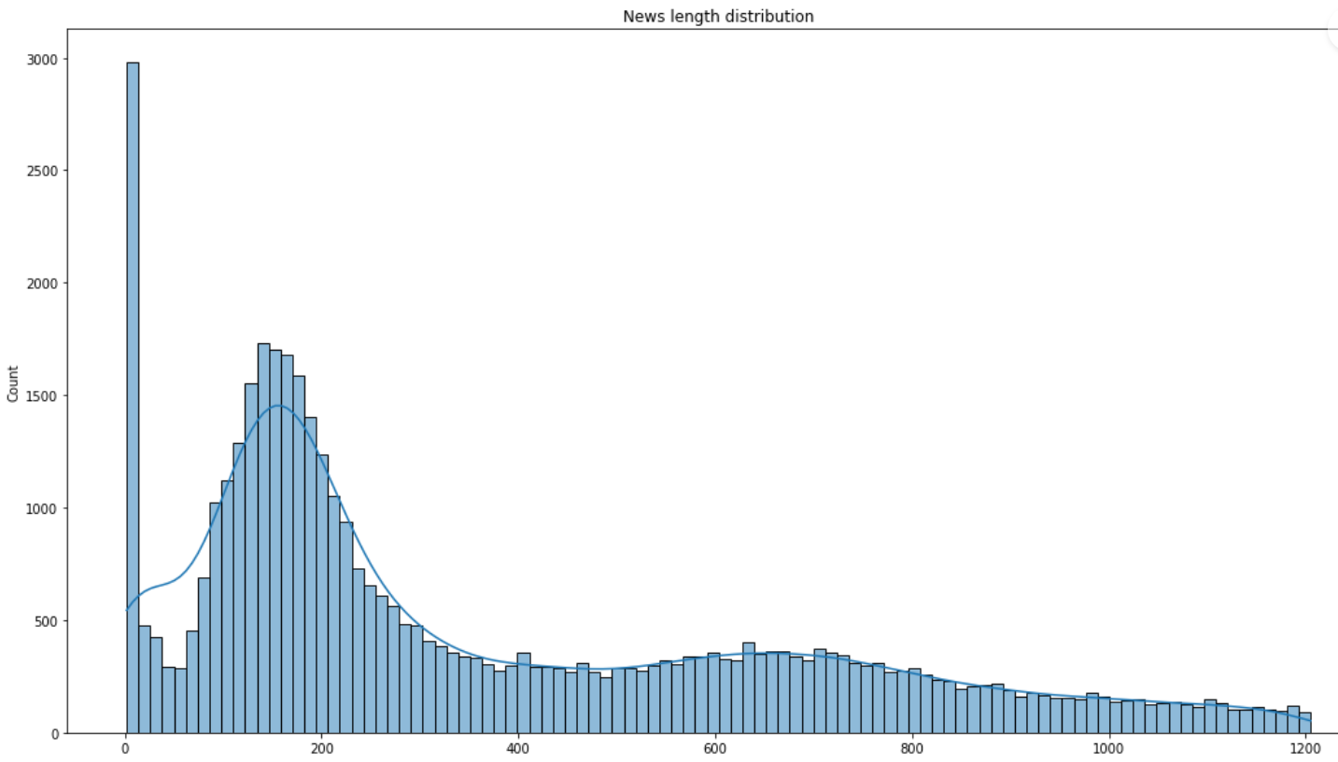
Progress
Organized two group meetings to discuss about the problem, methods and potential problems.
Done some literature reviews on some popular or state of the art natural language models.
Some exploratory data analysis has been done on the label balancing and some features of the text. From the exploratory data analysis, we find that since the class is imbalanced, we may need to do some over-sampling for some of the minor classes.
Summarized problems we may face and give potential solutions.
The long text problem: Most of the news documents are very long – more than half of them have more than 200 tokens which is not friendly to large models.
Possible solutions: 1. Simply truncate the news document to some fixed length like 256.
2. Build model to extract the main idea sentence of the news and then do classification.
3. Build generative model to generate main idea of the news and then classify.

Slide 10
Proposed Evaluation
These are the ways in which we plan to evaluate our project:
● Using Precision, Recall and F1 score to gauge how well our model is doing and get an idea of the accuracy. (Also calculating false positives, true positives, false negatives, and true negatives to compute the mentioned metrics)
● An excellent project outcome would be being able to predict the reliability of a document according to the 4-way classification labels with an accuracy greater than 70%. A satisfactory project outcome would be to be able to predict the reliability of a document according to the 4-way classification labels with an accuracy less than 70%.
● Reference to similar news reliability classifiers: https://iopscience.iop.org/article/10.1088/1757-899X/459/1/012006/pdf
https://www.ncbi.nlm.nih.gov/pmc/articles/PMC9516811/
Notes:
Precision recall, F1 score, AUC, propose a satisfactory project outcome, reference similar works

Slide 11
Resources
Data: - The dataset was originally constructed by Rashkin et al., 2017. - It consists of news corpus with varying reliability, including trustworthy news articles extracted from the English Gigaword News, and less credible articles sampled from various unreliable news sites including The Onion, The Borowitz Report, Clickhole, American News, DC Gazette, The Natural News and Activist Report. - The articles are classified into 4 classes: trusted, hoax, satire and propaganda
Compute: We will use Colab environment and its GPU. We may also use kaggle's GPU and the computing resources provided by the department.
Software: We will use the Pytorch framework and some available functions and model structures in it. We will include testing data for replicability.

Slide 12
Role Assignment/Schedule
Week | Task | PIC* | Status
07 | Pre-preocessing & EDA | Zhehao Gu | In progress
08 | Feature Engineering/Literature Reviews | Junhao Huang | In progress
09 | Long Text Problem/Modeling | Rongrong Zhan | Not started
10 | Modeling - Implementation | Modi Trushti Sanjaybhai | Not started
11 | Modeling – Implementation and Evaluation | Sagar Sureka | Not started
12 | Report Writing | All members | Not started
*We will all work together in each part, PIC would be the person in charge and monitor the progress.
Notes:
Indicating the dates by which you plan to complete project components. Make sure the schedule is plausible. You may find that a table format with the remaining weeks of the course helpful to describe this goal.
Grey out portions of the schedule that have past and state whether the goals of the past weeks have been met and how.
Due Thur. 6 Apr

Slide 13
References
[1] Mendeley (2018) How to cite sources in Harvard Citation Format - [Online]. Available at: https://www.mendeley.com/guides/harvard-citation-guide (Accessed: 22 Jun 2020)​
[2] ​Rashkin, H., Choi, E., Jang, J., Volkova, S., Choi, Y. and Allen, P. (2017). Truth of Varying Shades: Analyzing Language in Fake News and Political Fact-Checking. [online] Association for Computational Linguistics, pp.2931–2937. Available at: https://aclanthology.org/D17-1317.pdf.
[3] Vaswani, A., Shazeer, N., Parmar, N., Uszkoreit, J., Jones, L., Gomez, A. N., ... & Polosukhin, I. (2017). Attention is all you need. Advances in neural information processing systems, 30.
[4] Yang, Z., Dai, Z., Yang, Y., Carbonell, J., Salakhutdinov, R. R., & Le, Q. V. (2019). Xlnet: Generalized autoregressive pretraining for language understanding. Advances in neural information processing systems, 32.
[5] Liu, Y., Ott, M., Goyal, N., Du, J., Joshi, M., Chen, D., ... & Stoyanov, V. (2019). Roberta: A robustly optimized bert pretraining approach. arXiv preprint arXiv:1907.11692.
[6] Lan, Z., Chen, M., Goodman, S., Gimpel, K., Sharma, P., & Soricut, R. (2019). Albert: A lite bert for self-supervised learning of language representations. arXiv preprint arXiv:1909.11942.
[7] Dai, Z., Yang, Z., Yang, Y., Carbonell, J., Le, Q. V., & Salakhutdinov, R. (2019). Transformer-xl: Attentive language models beyond a fixed-length context. arXiv preprint arXiv:1901.02860.
[8] Clark, K., Luong, M. T., Le, Q. V., & Manning, C. D. (2020). Electra: Pre-training text encoders as discriminators rather than generators. arXiv preprint arXiv:2003.10555.‌

Slide 14
References
[9] 4 In 5 Singaporeans Confident in Spotting Fake News but 90 per Cent Wrong When Put to the Test: Survey | the Straits Times, 27 Sept. 2018, www.straitstimes.com/singapore/4-in-5-singaporeans-confident-in-spotting-fake-news-but-90-per-cent-wrong-when-put-to-the.
[10] Devlin, J., Chang, M.-W., Lee, K., Google, K. and Language, A. (2019). BERT: Pre-training of Deep Bidirectional Transformers for Language Understanding. [online] Available at: https://arxiv.org/pdf/1810.04805.pdf.
‌[11] Pennington, J., Socher, R. and Manning, C. (2014). GloVe: Global Vectors for Word Representation. [online] Available at: https://nlp.stanford.edu/pubs/glove.pdf.

Slide 15
Thanks!

